Slide 1

ACS 560 Software Engineering – Fall 2022 Project CarRental Architecture
Sanidhya Sharma Bibin Prakash Rajadurai Selvakumar Winnie Har
Notes:
To replace this picture, just select and delete it. Then use the Insert Picture icon to replace it with one of your own!

Slide 2
Major Modules

Slide 3
5 Major Modules
Authentication – all user account related functions
Rental Picker – displays available rental options
Booking – booking creations
Notification – notifications, confirmations and reminders
Cancellation – booking cancellations
We will redirect payment to third party gateway

Slide 4
Class Diagrams

Slide 5
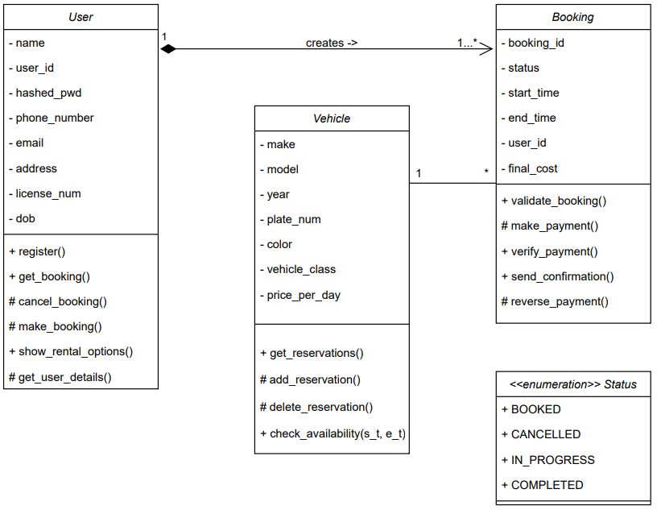
Class Diagram - Server

Slide 6
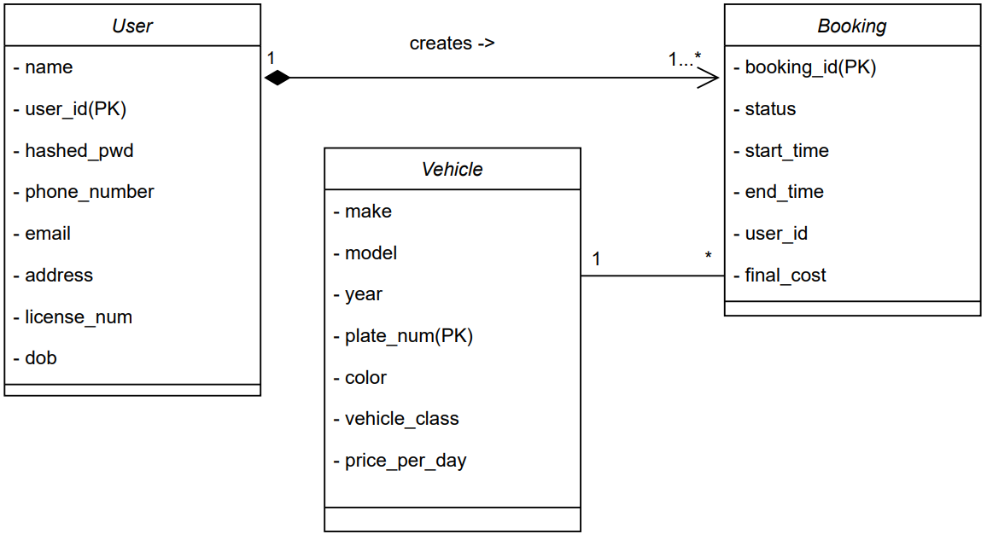
Class Diagram - Client

Slide 7
Sequence Diagrams

Slide 8
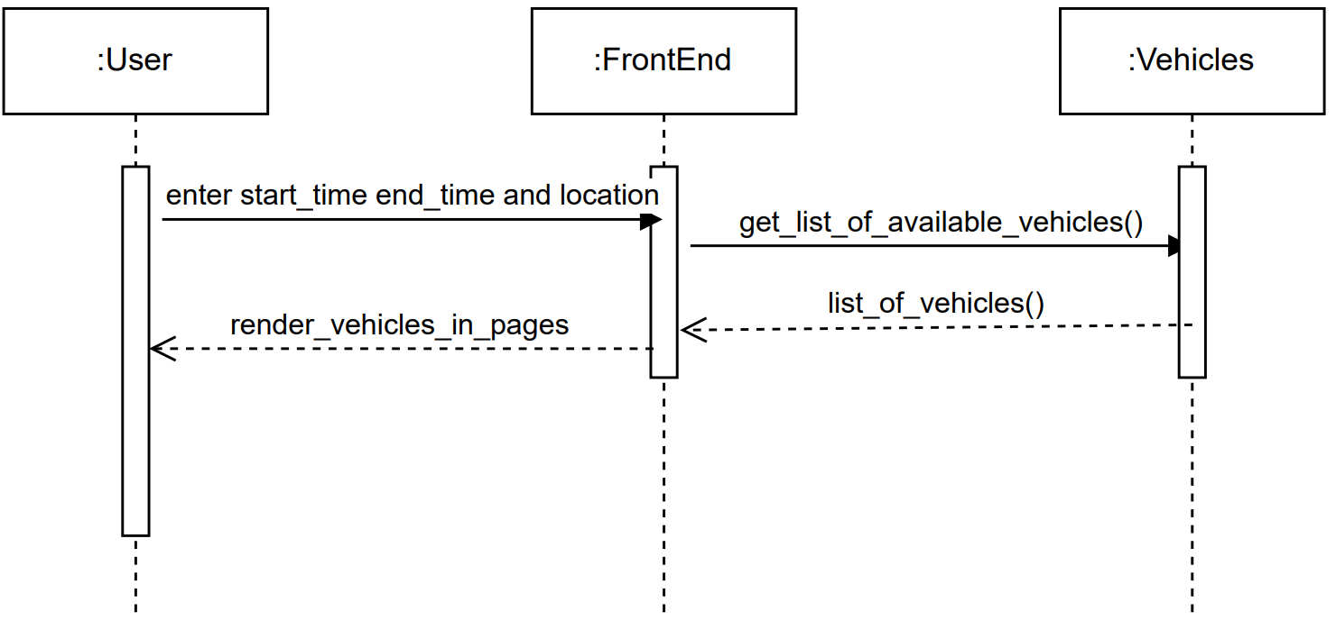
Sequence Diagram – Rental Picker

Slide 9
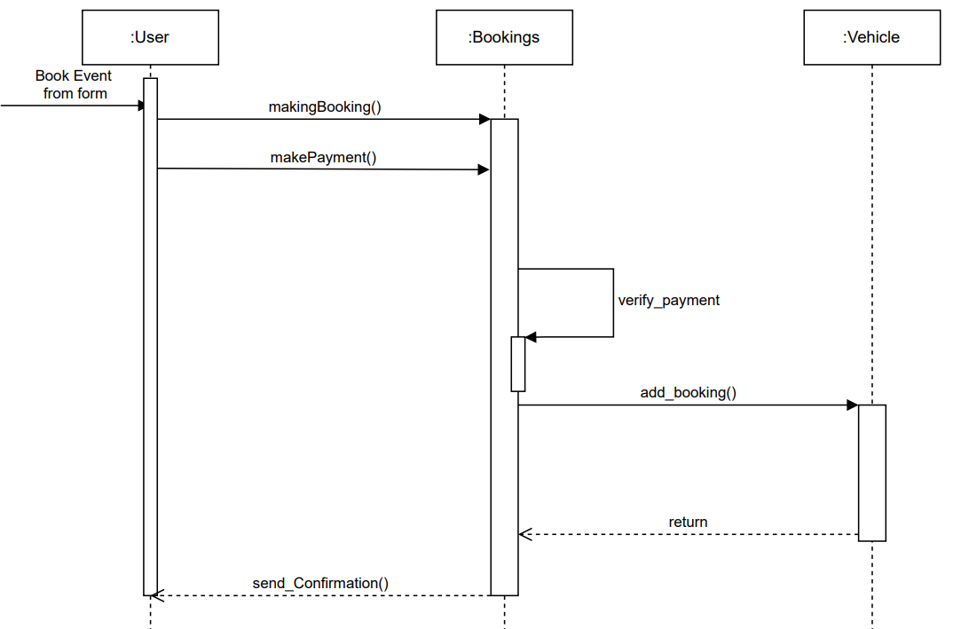
Sequence Diagram – Make Booking

Slide 10
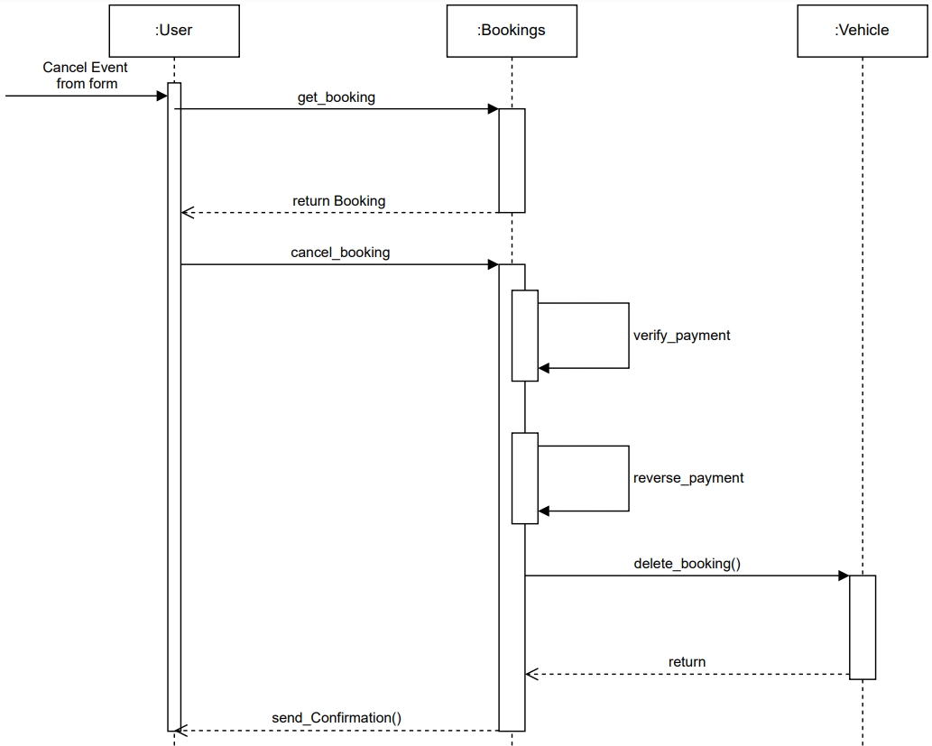
Sequence Diagram – Cancel Booking

